Slide 1
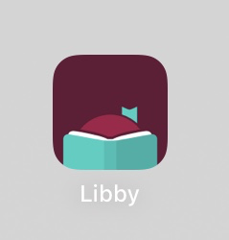
How to Install Libby
Chester County Library System’s ebook platform
Library sciences – Mrs. Golden – Oxford Area School District

Slide 2
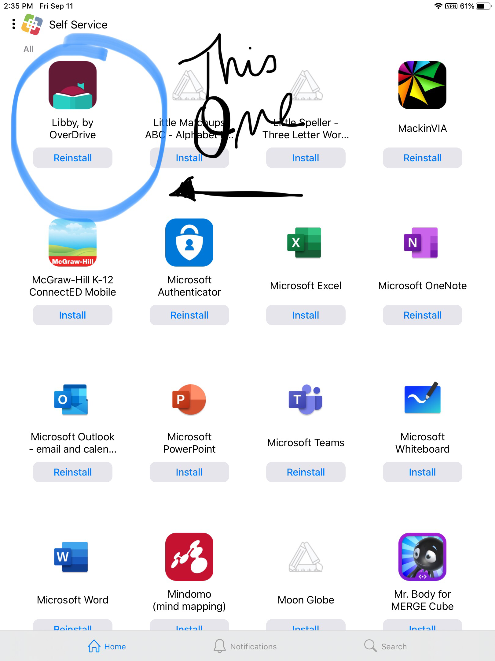
You can locate the Libby App from Self Service:

Slide 3
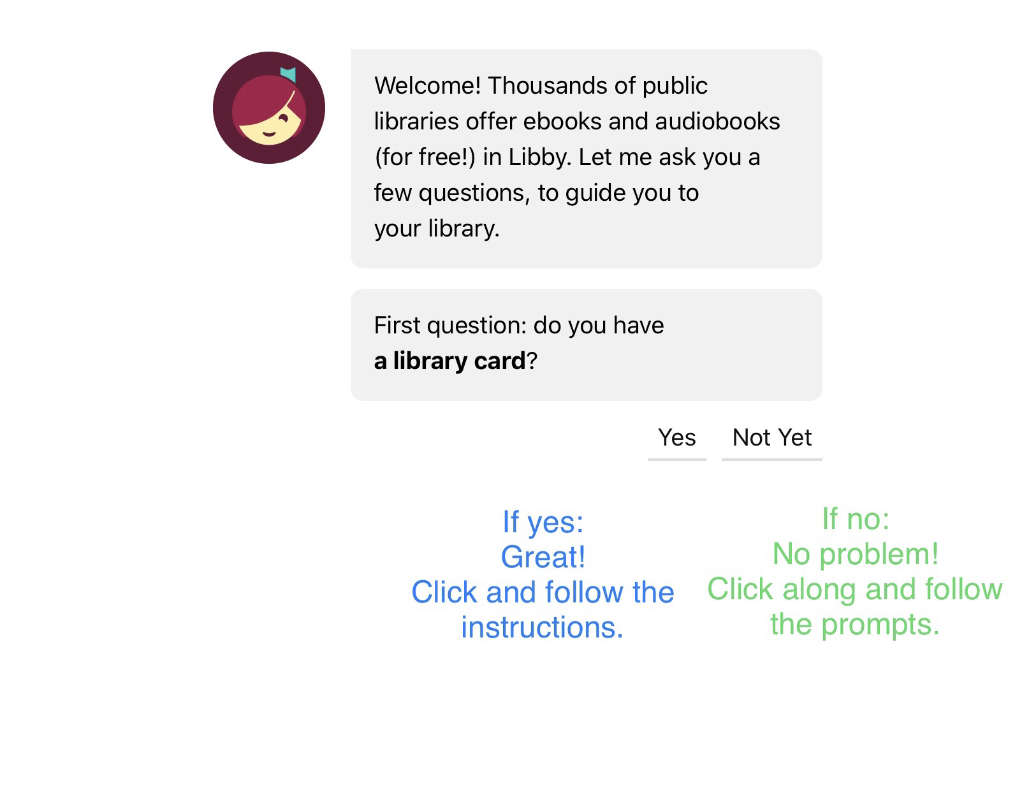
Once you launch the app, you will see this screen:
The next few slides will guide you if you have answered “Not yet.”

Slide 4
<— Click here!

Slide 7
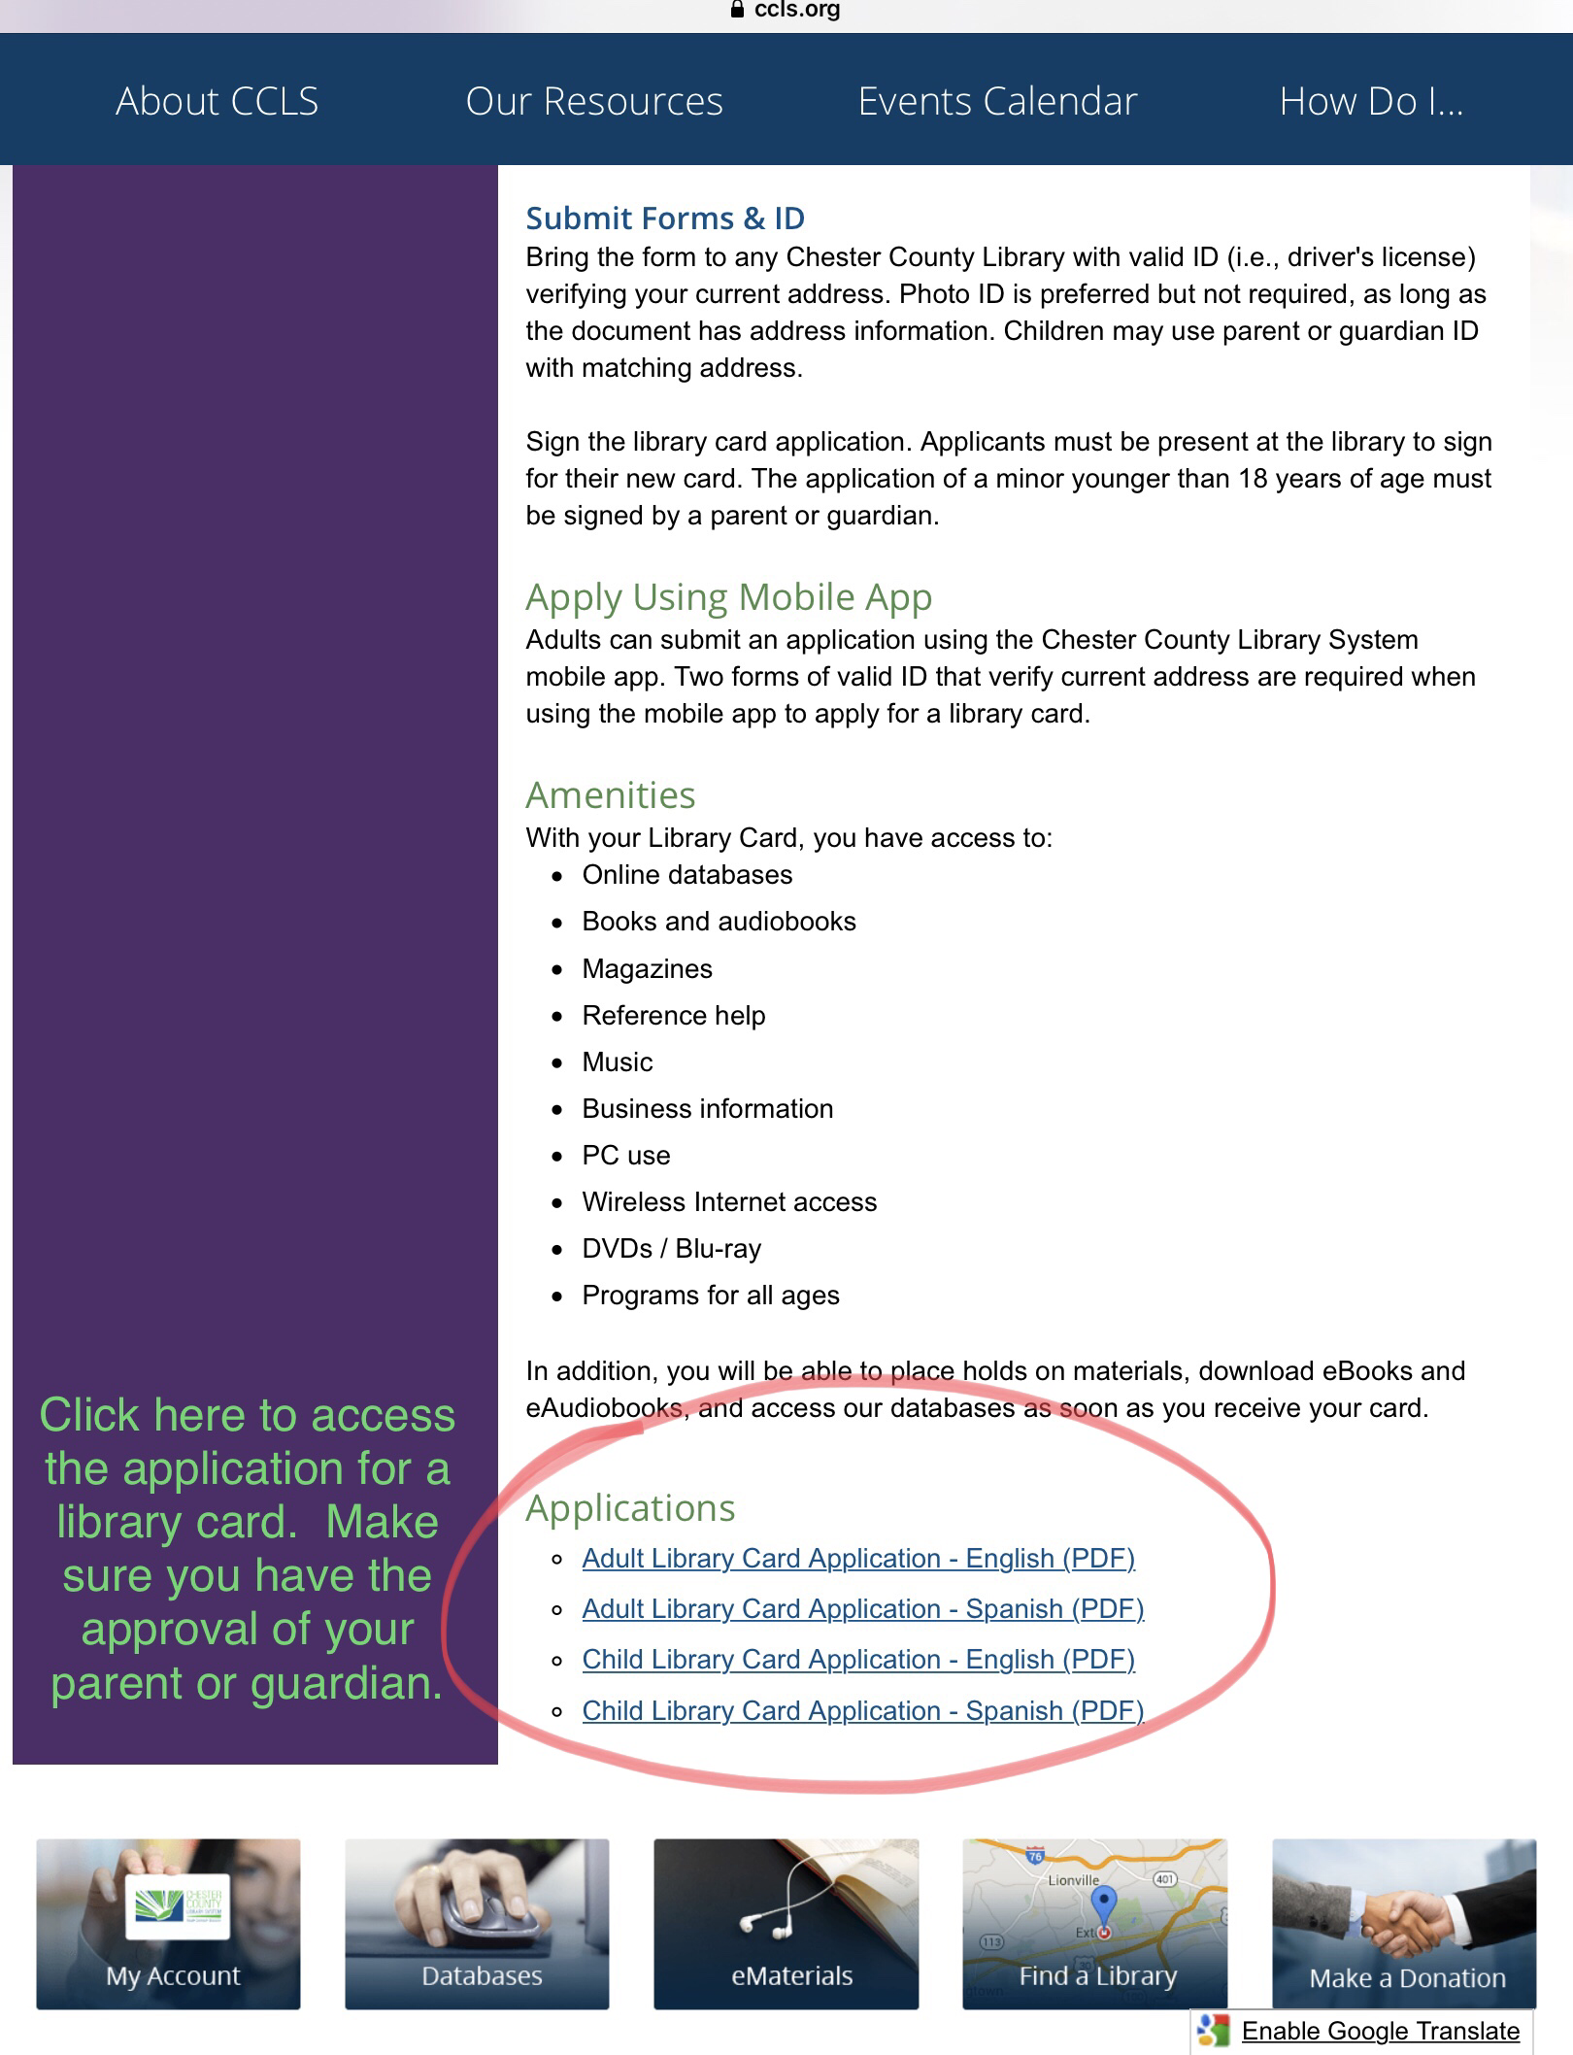
Scroll down until you can make your selection for a youth library card.

Slide 8
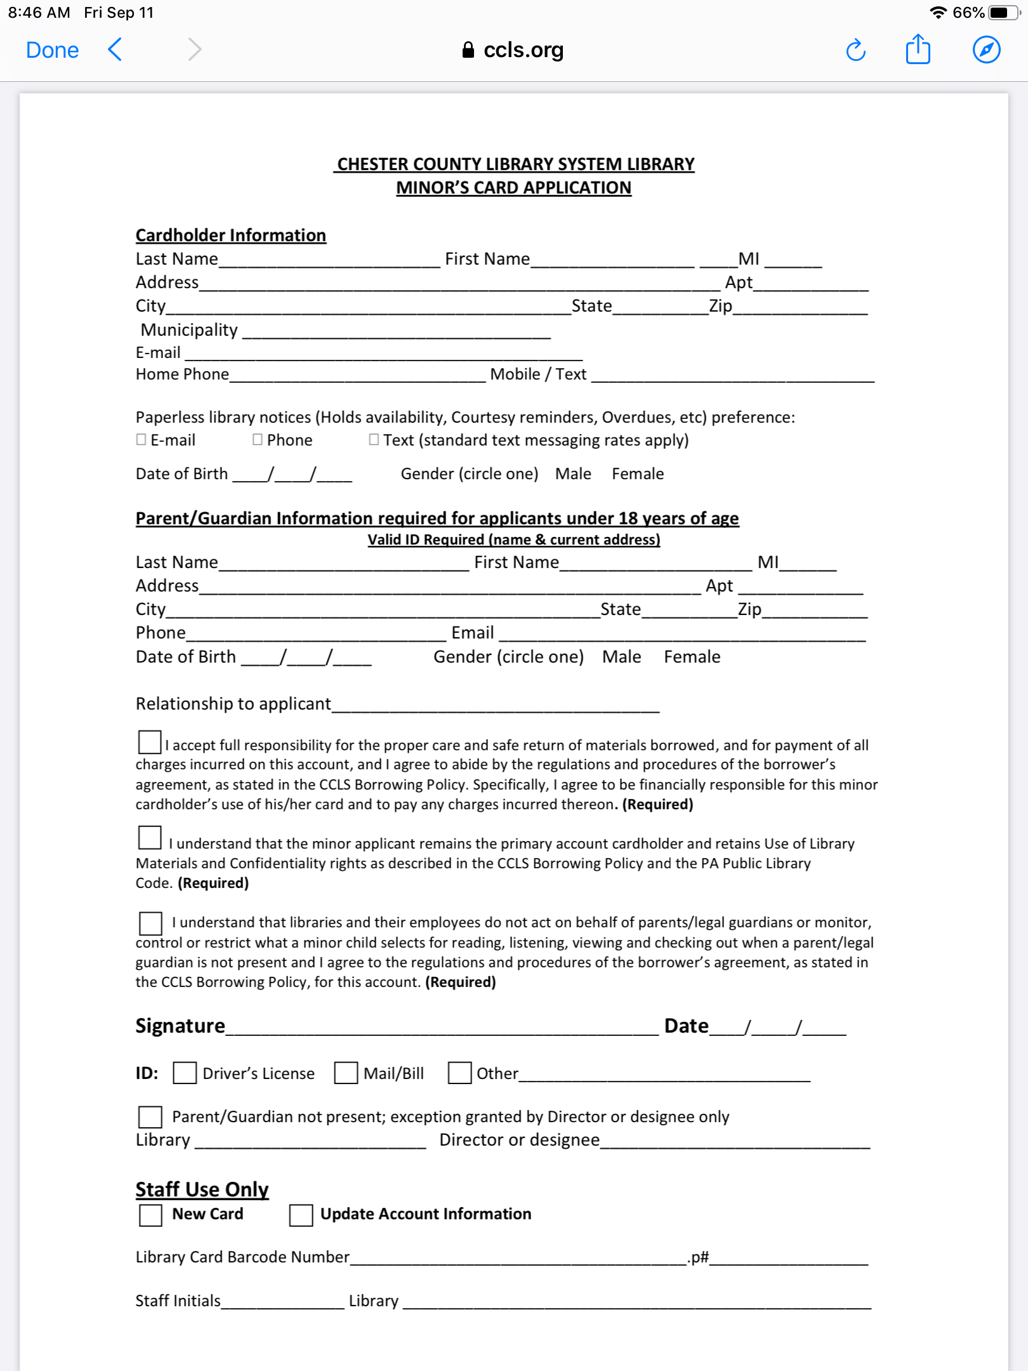
Child Library Card Application
Get approval of an adult at home before submitting your completed application for a library card.

Slide 9
En Espanol

